Slide 1




DIGITAL LITERACY
SKILLS

Slide 2
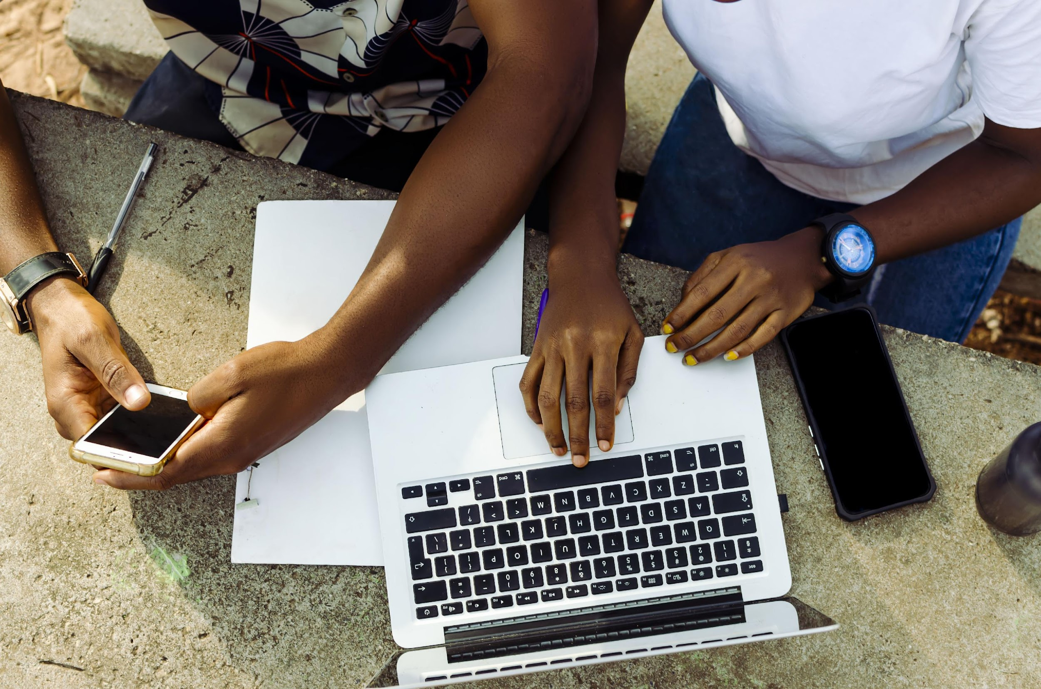
Module 1
Foundation digital skills

Slide 3

3
Unit 3: Introduction to the internet

Slide 4
Mobile internet and computer internet
The main differences between mobile internet and computer internet:
MOBILE INTERNET | COMPUTER INTERNET
Laptop, tablet, and smartphone | Laptop, desktop computer
The device does not need to have a cable to connect to the internet. It is wireless. | The device connects to the internet using a cable. It is wired.
The device connects using Wi-Fi or a mobile network. | The device connects using an ethernet port or a USB Wi-Fi adapter
Internet is available while the user is on the move, taking the device with them. | Internet is only available in the location where the device stays – so where the cable is.
The user connects to the internet by navigating to the network settings and joining a Wi-Fi network or activating mobile internet with their mobile network provider. | The user connects to the internet by plugging the ethernet cable into the ethernet port on their device.

Slide 5
Skills to practise
There are several ways to go online.
Type sentences in which you:
explain what mobile internet is
explain what computer internet is
provide steps for connecting to mobile internet
provide steps for connecting to computer internet
state which type you think is the best.

Slide 6

Going online
A mobile network is a regional or national network that connects devices with sim cards.
Towers send and receive radio signals from the sender to the receiver.
The interconnected towers form a network.
A Wi-Fi network is a wireless network and is created when a router connects to an internet service provider by wire or cable and then sends radio signals to nearby devices.

Slide 7
Skills to practise
Think about your favourite type of food.
Now, make sure you are connected to the internet.
Launch your browser.
Go to www.google.com.
In the search bar, type in the name of your favourite food and add the word recipe at the end. Then click search.
Open a few of the websites from your Google search.
Try to identify each of these components on a web page: menu, search bar, web address, back / forward, share, history, tabs, and refresh button.
Show a family member or friend each of these different components.

Slide 8
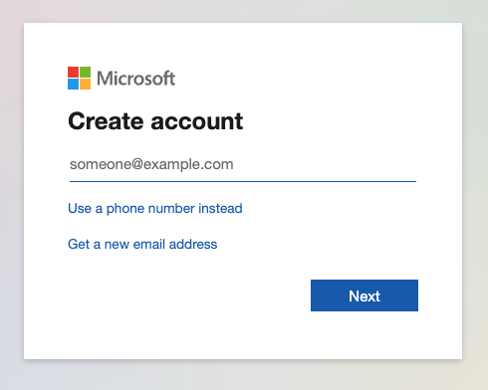
Setting up accounts
Email
Follow these steps to create an account:
Go to the sign-up section of the email platform
Complete personal details
Choose a username
Choose a password
Confirm the password
Read and agree to the Terms and Conditions.

Slide 9
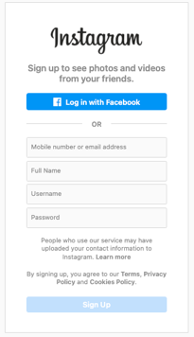
Setting up accounts
Social media
Follow these steps to open a social media account:
Go to the sign-up section of the social media platform.
Complete personal details.
Choose a username.
Choose a password.
Confirm the password.
Read and agree to the Terms and Conditions.

Slide 10
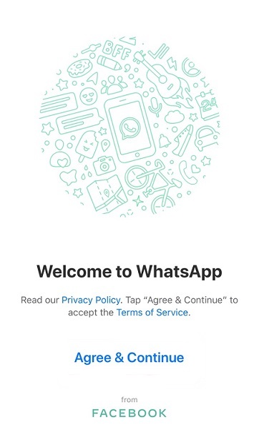
Setting up accounts
Chat
These are the basic steps:
Launch the chat app or software
Read and agree to the Terms and Conditions.
Enter the phone number.
Complete registration with a verification code.

Slide 11
Skills to practise
Open the email account you set up in class.
Explore the settings.
Find where to change your profile picture.
Upload a picture of your choice.
Choose one of the other social media platforms that you learnt about. It must be one that you did not set up an account for in class.
Complete the set-up steps.
Find where to change your profile picture.
Upload a picture of your choice.
Complete one other optional set-up.

Slide 12
All back covers should include
contact information of the section
producing the work.
© United Nations Children’s Fund (UNICEF) [month and year of publication]

